Slide 1

End Sem Presentation
21CSE314
Malaria Cell Image Classification using Deep Learning
Team No: E-15
P Dinesh Saravan - BL.EN.U4AIE21127
M Sai Subhash - BL.EN.U4AIE21135
S Venkata Mahesh - BL.EN.U4AIE21138
Submitted to:
Dr. Tripty Singh

Slide 2
Outline
Introduction
Problem statement
Data description
Proposed methodology
Results
Conclusion
References

Slide 3
Introduction
Malaria, a major disease in tropical regions, demands precise diagnosis for effective treatment.
Deep learning offers a solution by automatically identifying and classifying infected cells from blood samples, providing quick and accurate results.
This technology alleviates the workload for healthcare workers, particularly in resource-constrained regions.
This innovation has the potential to enhance global health and curb the spread of diseases.

Slide 4
Introduction
However, challenges such as limited annotated data sets, high processing times, and generalization issues must be addressed.
AI models using Convolutional Neural Networks (CNNs) can significantly enhance malaria diagnosis by automating the detection process, improving accuracy, and facilitating early treatment.
These models are particularly beneficial in resource-poor settings, enabling remote diagnosis and consultation through portable devices and telemedicine platforms, ultimately aiding in the early detection and management of malaria..

Slide 5
Problem Statement
Malaria diagnosis in tropical regions is hindered by the need for skilled professionals and resource-intensive methods.
This project aims to develop a deep learning-based system using convolutional neural networks (CNNs) to automatically classify malaria-infected cells from blood samples, providing a rapid, accurate, and efficient diagnostic tool for resource-limited areas. Key challenges include acquiring annotated datasets, managing computational demands, and ensuring model interpretability for clinical use.

Slide 6
Dataset Description
The Malaria dataset of cellular images contains 27,558 balanced images (parasitic and uninfected), half of them being typically infected with the Plasmodium parasite while the remaining uninfected.
In the dataset, we will use thin films of blood retrieved from the commonly used malaria diagnostic method. Each image shows the same red blood cell segmented in one single piece.The dataset contains 2 folders
Infected
Uninfected
JPEG images are the main source of training machine learning models that aim to automatically recognize malaria parasites and for developing image processing technologies for analysis of blood smears.

Slide 7
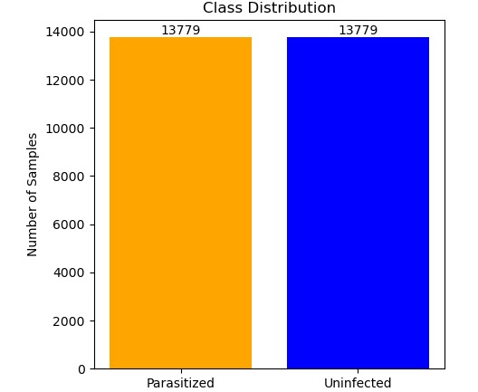
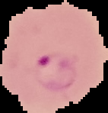

Sample Dataset Image
Parasitized and uninfected malaria cell
no. of samples in parasitized and unparasitized

Slide 8
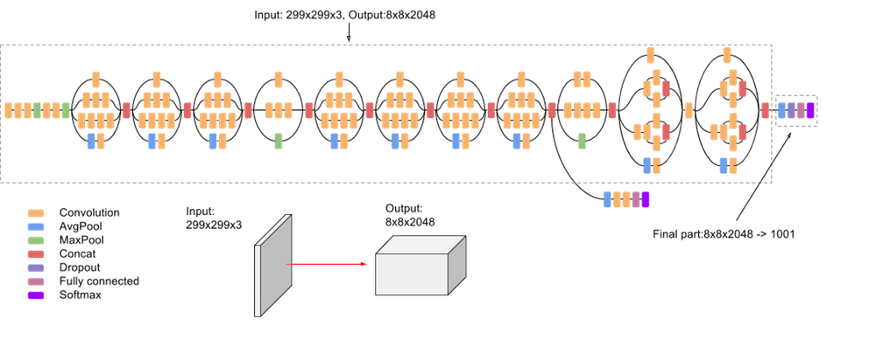
Proposed Methodology
Inception V3 :
Itcan efficiently extract features from cell images to distinguish between infected and uninfected cells.
Key steps include data preprocessing (resizing, normalization, and augmentation) and customizing the output layer for binary classification.
Fine-tuning the network ensures it adapts to malaria-specific features. Evaluating performance through metrics like accuracy, precision, recall, and F1-score, along with a confusion matrix, confirms the model's effectiveness in aiding early and reliable malaria diagnosis, enhancing healthcare outcomes in underserved areas.

Slide 9
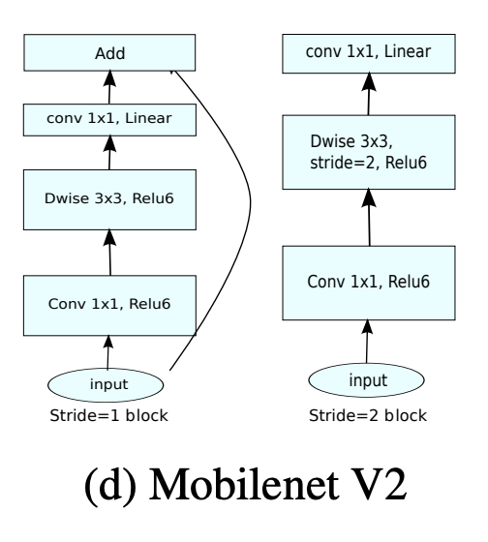
Proposed Methodology
Mobilenet V2:
The pre-trained MobileNetV2 model is fine-tuned on this dataset, enabling it to discern crucial features indicative of infection.
Performance metrics including accuracy, precision, and recall are computed to assess the model's efficacy in distinguishing between infected and uninfected cells.
Once validated, the model is primed for real-world deployment, potentially aiding healthcare workers in swift and accurate malaria diagnosis through integration into mobile applications or web services.

Slide 10
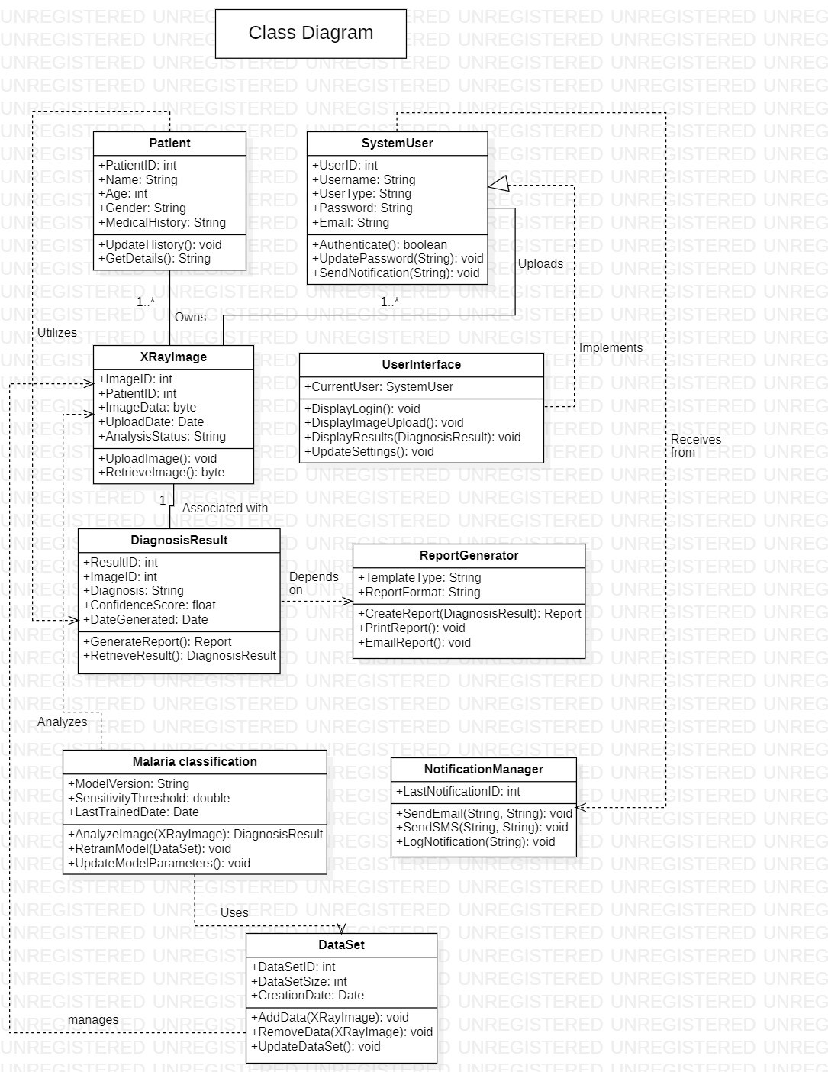
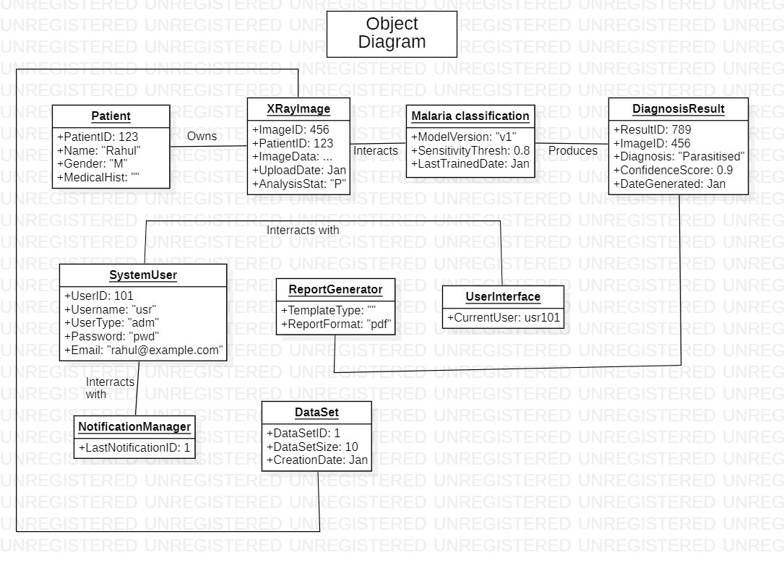
Proposed Methodology
UML Diagrams:

Slide 11
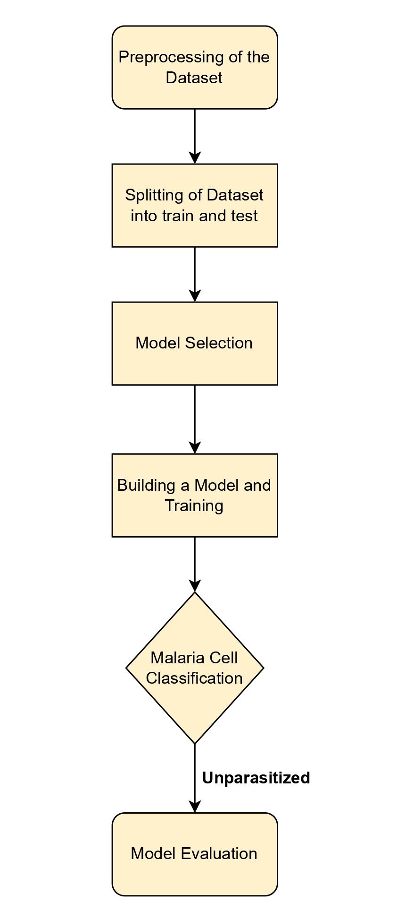
System Diagram

Slide 12
Results

Slide 13
Results

Slide 14
Conclusion
We have used Various deep learning models (InceptionV3, MobileNetV2, EfficientNet B3, ResNet50, and DenseNet201) were compared for diagnosing malaria using the same dataset.
Performance metrics considered were precision, recall, F1-score, accuracy, and loss.
DenseNet201 showed the best generalization and accuracy, with Renet50 and EfficientNet B3 as the next most desirable models.
InceptionV3 and MobileNetV2 also performed well, with MobileNetV2 excelling in most cases
And also we have explored the accuracy and Loss Performances Curves for all the models

Slide 15
References
[1] K. Sriporn, C. F. Tsai, C. E. Tsai, and P. Wang, "Analyzing malaria disease using effective deep learning approach," Diagnostics, vol. 10, no. 10, pp. 744, 2020.
[2] A. Çinar and M. Yildirim, "Classification of malaria cell images with deep learning architectures," Ingénierie des Systems information, vol. 25, no. 1, pp. 35, 2020.
[3] T. Banerjee, A. Jain, S. C. Sethuraman, S. C. Satapathy, S. Karthikeyan, and A. Jubilson, "Deep Convolutional Neural Network (Falcon) and transfer learning‐based approach to detect malarial parasite," Multimedia Tools and Applications, vol. 81, no. 10, pp. 13237-13251, 2022.
[4] G. Shekar, S. Revathy, and E. K. Goud, "Malaria detection using deep learning," in 2020 4th international conference on trends in electronics and informatics (ICOEI), pp. 746-750, IEEE, June 2020..
[5] K. Hemachandran, A. Alasiry, M. Marzougui, S. M. Ganie, A. A. Pise, M. T. H. Alouane, and C. Chola, "Performance analysis of deep learning algorithms in diagnosis of malaria disease," Diagnostics, vol. 13, no. 3, pp. 534, 2023.

Slide 16
References
[6] M. Turuk, R. Sreemathy, S. Kadiyala, S. Kotecha, and V. Kulkarni, "CNN Based Deep Learning Approach for Automatic Malaria Parasite Detection," IAENG Int. J. Comput. Sci, vol. 49, pp. 745-753, 2022.
[7] S. V. Militante, "Malaria disease recognition through adaptive deep learning models of convolutional neural network," in 2019 IEEE 6th International Conference on Engineering Technologies and Applied Sciences (ICETAS), pp. 1-6, IEEE, December 2019.
[8] S. Suraksha, C. Santhosh, and B. Vishwa, "Classification of Malaria cell images using Deep Learning Approach," in 2023 Third International Conference on Advances in Electrical, Computing, Communication and Sustainable Technologies (ICAECT), pp. 1-5, IEEE, January 2023.
[9] K. S. Gill, V. Anand, and R. Gupta, "An Efficient VGG19 Framework for Malaria Detection in Blood Cell Images," in 2023 3rd Asian Conference on Innovation in Technology (ASIANCON), pp. 1-4, IEEE, August 2023.
[10] Y. M. Kassim, K. Palaniappan, F. Yang, M. Poostchi, N. Palaniappan, R. J. Maude, S. Antani, and S. Jaeger, "Clustering-based dual deep learning architecture for detecting red blood cells in malaria diagnostic smears," IEEE Journal of Biomedical and Health Informatics, vol. 25, no. 5, pp. 1735-1746, 2020.

Slide 17
THANK YOU!

